Slide 1

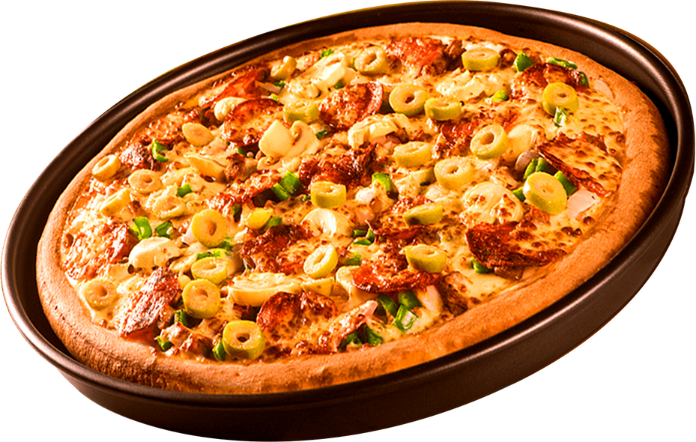


PIZZA SALES ANALYSIS
Enjoy the SQL

Slide 2



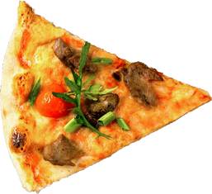

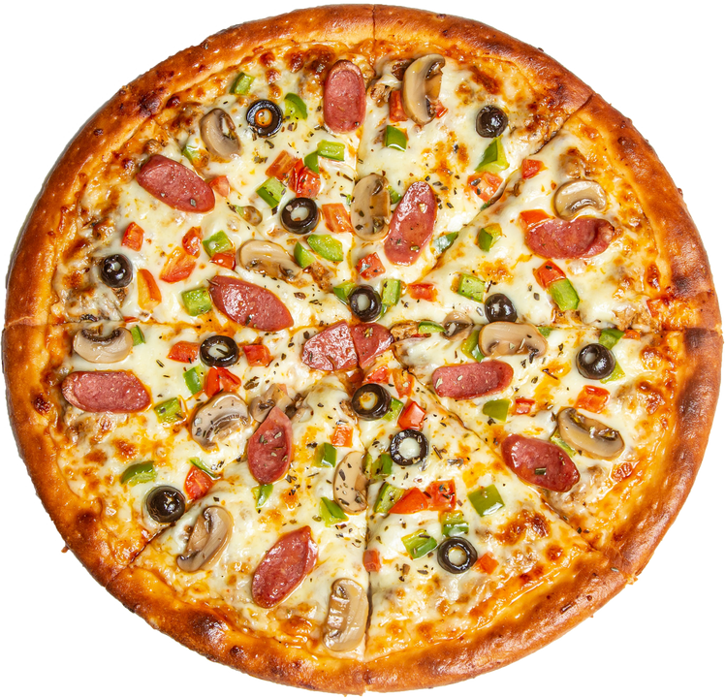





Hello
GREETING ALL
I am Md Faizan Ahmad , Being a Data Analyst I solved several query related to pizza sales.

Slide 3


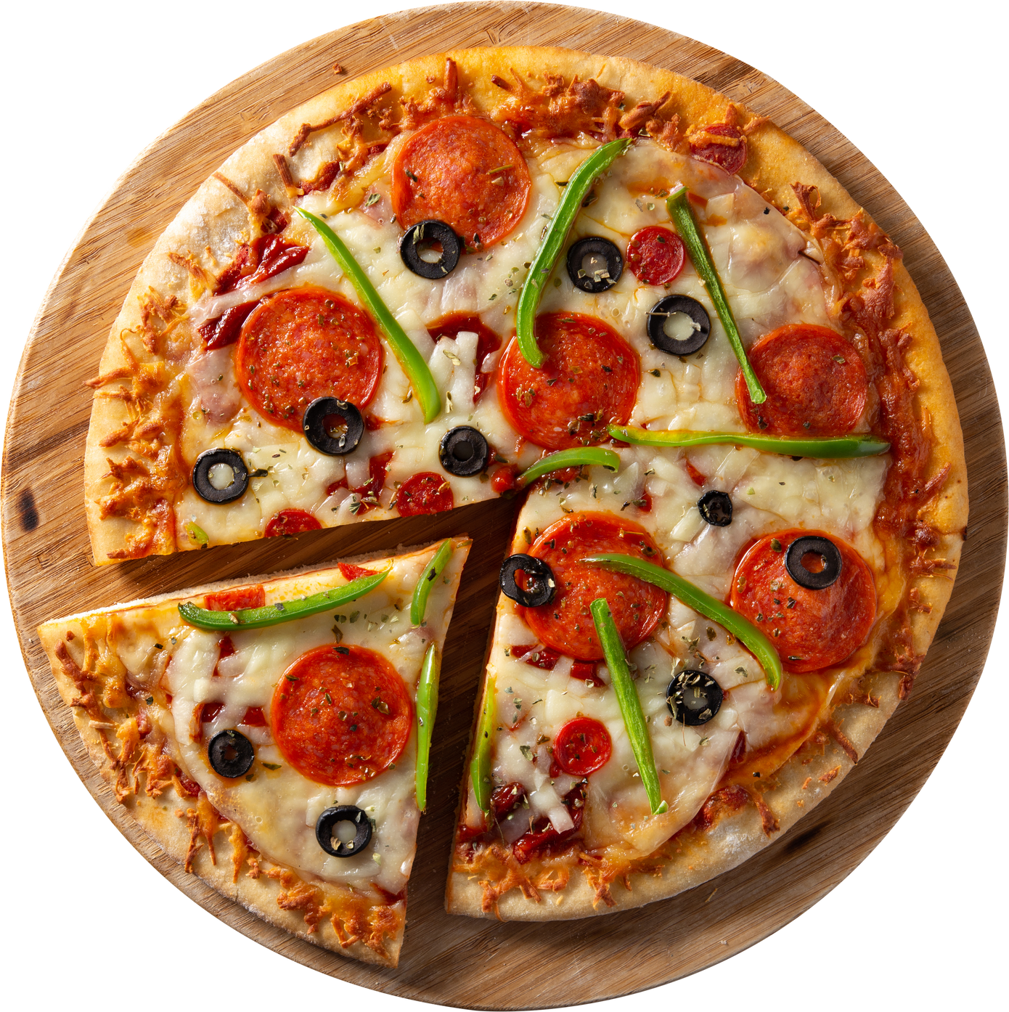
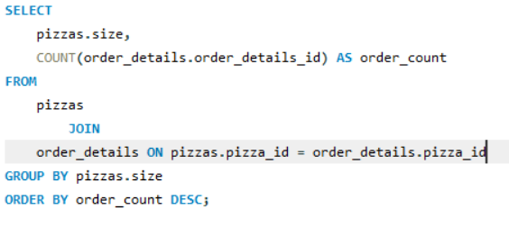
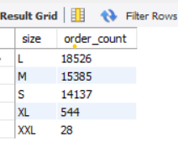
PIZZA
TIME
QUE:- IDENTIFY THE MOST COMMON PIZZA SIZE ORDERED
Md Faizan Ahmad

Slide 4
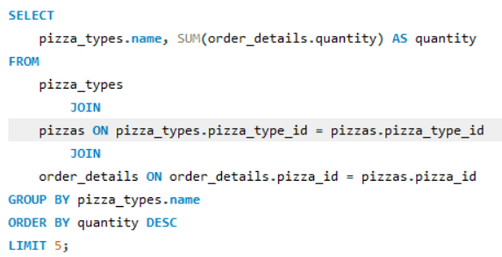
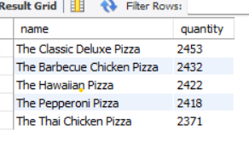
QUE:- LIST THE TOP 5 MOST ORDERED PIZZA TYPES along with their quantities.

Slide 5
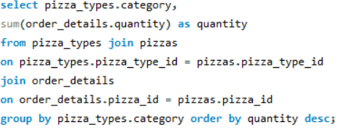
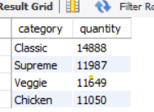
QUE:- JOIN THE NECESSARY TABLES TO FIND THE TOTAL QUANTITY OF EACH PIZZA CATEGORY ORDERED.

Slide 6
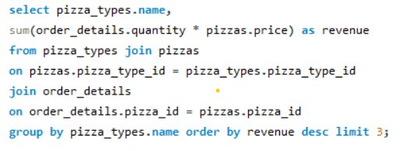
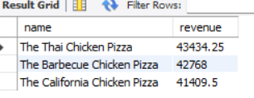
QUE:- DETERMINE THE TOP 3 MOST ORDERED PIZZA TYPES BASED ON REVENUE.

Slide 7
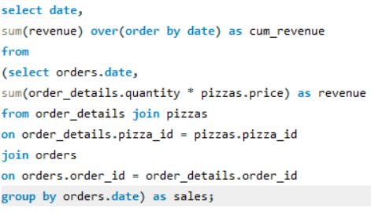
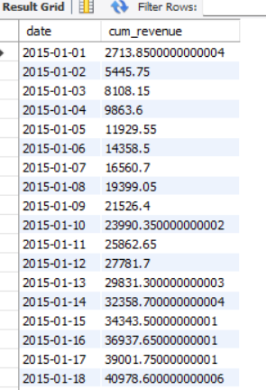
QUE:- ANALYZE THE CUMULATIVE REVENUE GENERATED OVER TIME.

Slide 8
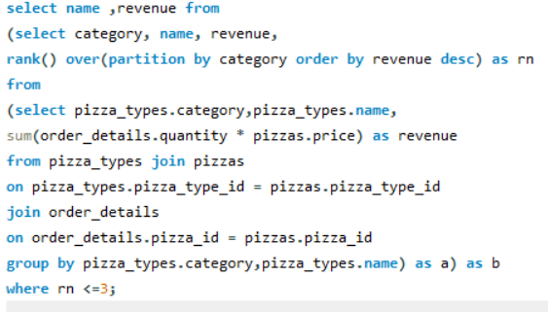
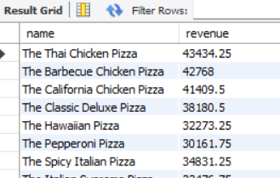
QUE:- DETERMINE THE TOP 3 MOST ORDERED PIZZA TYPES BASED ON REVENUE FOR EACH PIZZA CATEGORY.

Slide 9
THANK YOU
MD FAIZAN AHMAD

